Slide 1
Harmony in Nature iz—fr esa O;oLFkk

Slide 2
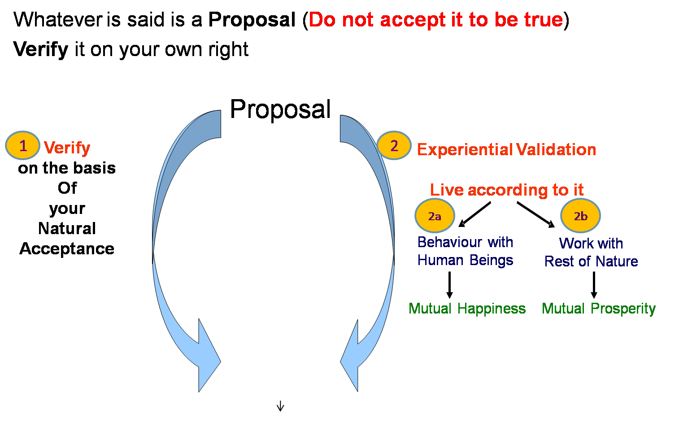
Self-exploration, Self-investigation, Self-study
1. Content of Self Exploration:
  a. Desire (pkguk) - Aim, Purpose
  b. Program (djuk) – Process of achieving the desire, action
Happiness = To be in Harmony
2. Process of Self Exploration
Self-verification
– Happiness, Prosperity → Continuity
To understand Harmony & to live in harmony at all 4 levels:
  Harmony in the Human Being
  Harmony in the Family
  Harmony in the Society
  Harmony in Nature/Existence

Slide 3
Next we want to explore Nature/Existence
So far we have understood our Natural Acceptance
Our Natural Acceptance is for living in Harmony – as an Individual, as a Family, as a Society…
Is there provision in Nature/Existence for living in accordance with our Natural Acceptance?
Is it possible to live in harmony as an Individual, as a Family, as a Society…?
Is co-existence, mutual fulfillment inherent in Nature?
Or
Is the design of nature/existence by way of opposition, struggle, survival of the fittest…?
We will explore the underlying design of Nature/Existence with these questions…

Slide 4
Nature iz—fr
Nature iz—fr = Collection of Units bdkbZ lewg
Unit = Activity = In the form of individual unit
4 Orders
Relationship of Mutual Fulfilment
Material
tM
Consciousness
pSrU;

Slide 5
Right Understanding, Knowing
To be able to see the reality as it is
Diversity
For a unit (activity) to be able to see its:
  Form
  Property (effect on other unit)
  Natural Characteristic (participation in larger order)
  Innateness (self organisation)
  Co-existence
      Definiteness, Continuity, Universality
Contemplation
Understanding
Realisation
Right Understanding

Slide 6
Nature = Collection of Units = 4 Orders
Recognizing, Fulfillment
Pranic Order
Plants, Trees
izk.k voLFkk
isM+] ikS/ks
Assuming,
Recognizing, Fulfillment
Recognizing, Fulfillment
Physical Order
Soil, Metal
inkFkZ voLFkk
feV~Vh] /kkrq
Animal Order
Animals, Birds
tho voLFkk
i”kq+] i{kh
Human Order
Human Being
Kku voLFkk
euq’;
Self (I) + Body
The presence of Self is
indicated by the presence
of the activity of Assuming
To understand the other
three orders, right understanding
of the Human Order is required,
otherwise over-evaluation, under-
evaluation or otherwise evaluation of the other orders takes place.
Self (I) + Body
Assuming, Recognizing,
Fulfillment & Potential of Knowing

Slide 7
Relationship of Mutual Fulfillment ijLij iwjdrk dk laca/k
Mutual Fulfillment = Relatedness + Fulfillment
ijLij iwjdrk = ijLijrk + iwjdrk
Pranic Order
Plants, Trees
izk.k voLFkk
isM+] ikS/ks
Physical Order
Soil, Metal
inkFkZ voLFkk
feV~Vh] /kkrq
Animal Order
Animals, Birds
tho voLFkk
i”kq+] i{kh
?
?
?
Human Order
Human Being
Kku voLFkk
euq’;

Slide 8
Relationship of Mutual Fulfillment
Four orders in nature, mutual fulfillment in nature
  In nature all the three orders other than human order are mutually fulfilling for themselves as well as for human beings
  Mutual fulfillment is naturally acceptable to the human order
  Due to lack of right understanding, the Human order is not yet able to ensure mutual fulfillment. This can be seen in the form of problems such as pollution, resource depletion, extinction of animals, global warming and threats to human race on earth
  Activity: An Inconvenient Truth
Pranic Order
Plants
Physical Order
Soil, Water, Air
Animal Order
Animals & Birds
?
?
?
Human Order
Human Being

Slide 9
Inheritence or Conformance = Anushangita = Anukram mein kaise saath saath chalta hai
When we understand anushangitam we are clear about "what to do" while interacting with:
  Human Being – ensure Human Education-Sanskar
  Animal – ensure will to live
  Plant – ensure growth
  Material – ensure existence
  (eg. Constitution of earth – coal)
This ensures mutual fulfillment. Then the qs marks become tick marks

Slide 10
Resource Depletion & Pollution
Resource Depletion – The resource is used at a rate which is faster than the rate at which it is produced in Nature
lalk/ku vHkko & mRiknu esa iz;qDr laalk/ku dh xfr] mlds izd`fr esa iSnk gksus dh xfr ls T;knk gS
Pollution – The product is such that
  It does not return to the cycle in Nature or
  It is produced at a rate that is faster than the rate at which it can return to the cycle in Nature
iznw’k.k & mRiknu ,slk gS fd
  1- mRikfnr oLrq pØ esa okil ugha vkrh ;k
  2- mldh xfr izkd`frd pØz esa okil tkus dh xfr T;knk gS

Slide 11
Harmony in Nature iz—fr esa O;oLFkk
ORDERS 4 voLFkk | UNITS bdkbZ | ACTIVITY fØz;k | INNATENESS /kkj.kk (Self-organisation) | INHERITANCE vuq’kaxh;rk
Physical inkFkZ | Soil, Metal feV~Vh] /kkrq | Composition-Decomposition jpuk&fojpuk | Existence vfLrRo | Constitution based Ikfj.kke vuq’kaxh
Pranic izk.k | Plants, Trees isM+] ikS/ks | "-“ + Respiration “olu&iz”olu | " + Growth iqf’V | Seed based cht vuq’kaxh
Animal tho | Animals, Birds i”kq] i{kh | "-“, " in Body “kjhj esa Selecting/Tasting in I p;u@vkLoknu eSa esa | ", " in Body “kjhj esa Will to live in I eSa esa Tkhus dh vk”kk | Breed based oa”k vuq’kaxh
Human Kku | Human Beings euq’; | "-“, " in Body “kjhj esa Imaging, Analysing, Selecting/Tasting in I fp=.k] fo'kys'k.k] p;u@vkLoknu eSa esa Potential for Understanding in I le>us dh {kerk eSa esa | ", " in Body “kjhj esa Will to live with continuous happiness in I eSa esa fujarj Lkq[kiwoZd Tkhus dh vk”kk | Education-Sanskar based f”k{kk&laLdkj vuq’kaxh

Slide 12
Harmony in Nature iz—fr esa O;oLFkk
ORDERS 4 voLFkk | UNITS bdkbZ | ACTIVITY fØz;k | INNATENESS /kkj.kk (Self-organisation) | INHERITANCE vuq’kaxh;rk
Physical inkFkZ | Soil, Metal feV~Vh] /kkrq | Composition-Decomposition jpuk&fojpuk | Existence vfLrRo | Constitution based Ikfj.kke vuq’kaxh
Pranic izk.k | Plants, Trees isM+] ikS/ks | "-“ + Respiration “olu&iz”olu | " + Growth iqf’V | Seed based cht vuq’kaxh
Animal tho | Animals, Birds i”kq] i{kh | "-“, " in Body “kjhj esa Selecting/Tasting in I p;u@vkLoknu eSa esa | ", " in Body “kjhj esa Will to live in I eSa esa Tkhus dh vk”kk | Breed based oa”k vuq’kaxh
Human Kku | Human Beings euq’; | "-“, " in Body “kjhj esa Imaging, Analysing, Selecting/Tasting in I fp=.k] fo'kys'k.k] p;u@vkLoknu eSa esa Potential for Understanding in I le>us dh {kerk eSa esa | ", " in Body “kjhj esa Will to live with continuous happiness in I eSa esa fujarj Lkq[kiwoZd Tkhus dh vk”kk Right Feeling & Thought lek/kku Right Understanding Kku | Education-Sanskar based f”k{kk&laLdkj vuq’kaxh
Innateness: Self Organisation; being in a definite order

Slide 13
Harmony in Nature iz—fr esa O;oLFkk
ORDERS 4 voLFkk | UNITS bdkbZ | ACTIVITY fØz;k | INNATENESS /kkj.kk (Self-organisation) | INHERITANCE vuq’kaxh;rk
Physical inkFkZ | Soil, Metal feV~Vh] /kkrq | Composition-Decomposition jpuk&fojpuk | Existence vfLrRo | Constitution based Ikfj.kke vuq’kaxh
Pranic izk.k | Plants, Trees isM+] ikS/ks | "-“ + Respiration “olu&iz”olu | " + Growth iqf’V | Seed based cht vuq’kaxh
Animal tho | Animals, Birds i”kq] i{kh | "-“, " in Body “kjhj esa Selecting/Tasting in I p;u@vkLoknu eSa esa | ", " in Body “kjhj esa Will to live in I eSa esa Tkhus dh vk”kk | Breed based oa”k vuq’kaxh
Human Kku | Human Beings euq’; | "-“, " in Body “kjhj esa Imaging, Analysing, Selecting/Tasting in I fp=.k] fo'kys'k.k] p;u@vkLoknu eSa esa Potential for Understanding in I le>us dh {kerk eSa esa | ", " in Body “kjhj esa Will to live with continuous happiness in I eSa esa fujarj Lkq[kiwoZd Tkhus dh vk”kk Right Feeling & Thought lek/kku Right Understanding Kku | Education-Sanskar based f”k{kk&laLdkj vuq’kaxh
Inheritance: Basis of definite conduct across generations

Slide 14
Role of Education-Sanskar f'k{kk&laLdkj dh Hkwfedk
ORDERS 4 voLFkk | UNITS bdkbZ | ACTIVITY fØz;k | INNATENESS /kkj.kk (Self-organisation) | INHERITANCE vuq’kaxh;rk
Physical inkFkZ | Soil, Metal feV~Vh] /kkrq | Composition-Decomposition jpuk&fojpuk | Existence vfLrRo | Constitution based Ikfj.kke vuq’kaxh
Pranic izk.k | Plants, Trees isM+] ikS/ks | "-“ + Respiration “olu&iz”olu | " + Growth iqf’V | Seed based cht vuq’kaxh
Animal tho | Animals, Birds i”kq] i{kh | "-“, " in Body “kjhj esa Selecting/Tasting in I p;u@vkLoknu eSa esa | ", " in Body “kjhj esa Will to live in I eSa esa Tkhus dh vk”kk | Breed based oa”k vuq’kaxh
Human Kku | Human Beings euq’; | "-“, " in Body “kjhj esa Imaging, Analysing, Selecting/Tasting in I fp=.k] fo'kys'k.k] p;u@vkLoknu eSa esa Potential for Understanding in I le>us dh {kerk eSa esa | ", " in Body “kjhj esa Will to live with continuous happiness in I eSa esa fujarj Lkq[kiwoZd Tkhus dh vk”kk Right Feeling & Thought lek/kku Right Understanding Kku | Education-Sanskar based f”k{kk&laLdkj vuq’kaxh
Next Generation
Human Tradition
Human Education-sanskar
Inheritance: Basis of definite conduct across generations

Slide 15
Role of Education-Sanskar f'k{kk&laLdkj dh Hkwfedk
ORDERS 4 voLFkk | UNITS bdkbZ | ACTIVITY fØz;k | INNATENESS /kkj.kk (Self-organisation) | NATURAL CHARACTERISTIC LoHkko (Participation) | INHERITANCE vuq’kaxh;rk
Physical inkFkZ | Soil, Metal feV~Vh] /kkrq | Composition-Decomposition jpuk&fojpuk | Existence vfLrRo | Composition-Decomposition LakxBu&fo?kVu | Constitution based Ikfj.kke vuq’kaxh
Pranic izk.k | Plants, Trees isM+] ikS/ks | "-“ + Respiration “olu&iz”olu | " + Growth iqf’V | " + Nurture-Worsen lkjd&ekjd | Seed based cht vuq’kaxh
Animal tho | Animals, Birds i”kq] i{kh | "-“, " in Body “kjhj esa Selecting/Tasting in I p;u@vkLoknu eSa esa | ", " in Body “kjhj esa Will to live in I eSa esa Tkhus dh vk”kk | ", " in body “kjhj esa Cruelty, Non-cruelty in I eSa esa Øwjrk] vØwjrk | Breed based oa”k vuq’kaxh
Human Kku | Human Beings euq’; | "-“, " in Body “kjhj esa Imaging, Analysing, Selecting/Tasting in I fp=.k] fo'kys'k.k] p;u@vkLoknu eSa esa Potential for Understanding in I le>us dh {kerk eSa esa | ", " in Body “kjhj esa Will to live with continuous happiness in I eSa esa fujarj Lkq[kiwoZd Tkhus dh vk”kk Right Feeling & Thought lek/kku Knowledge Kku | ", " in body “kjhj esa Perseverance, Bravity, Generosity in I eSa esa /khjrk] ohjrk] mnkjrk | Education-Sanskar based f”k{kk&laLdkj vuq’kaxh
Next Generation
Human Tradition
Human Education-sanskar

Slide 16
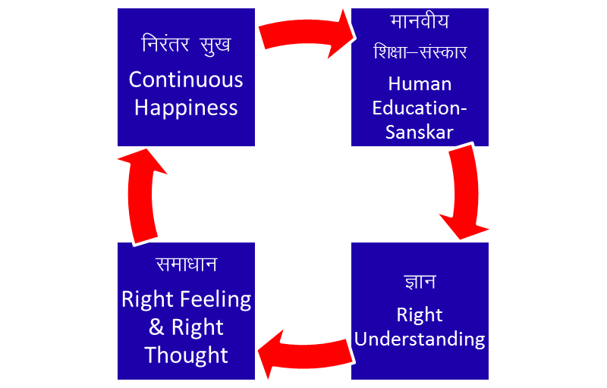
Role of Education-Sanskar f'k{kk&laLdkj dh Hkwfedk
ORDERS 4 voLFkk | UNITS bdkbZ | ACTIVITY fØz;k | INNATENESS /kkj.kk (Self-organisation) | INHERITANCE vuq’kaxh;rk
Physical inkFkZ | Soil, Metal feV~Vh] /kkrq | Composition-Decomposition jpuk&fojpuk | Existence vfLrRo | Constitution based Ikfj.kke vuq’kaxh
Pranic izk.k | Plants, Trees isM+] ikS/ks | "-“ + Respiration “olu&iz”olu | " + Growth iqf’V | Seed based cht vuq’kaxh
Animal tho | Animals, Birds i”kq] i{kh | "-“, " in Body “kjhj esa Selecting/Tasting in I p;u@vkLoknu eSa esa | ", " in Body “kjhj esa Will to live in I eSa esa Tkhus dh vk”kk | Breed based oa”k vuq’kaxh
Human Kku | Human Beings euq’; | "-“, " in Body “kjhj esa Imaging, Analysing, Selecting/Tasting in I fp=.k] fo'kys'k.k] p;u@vkLoknu eSa esa Potential for Understanding in I le>us dh {kerk eSa esa | ", " in Body “kjhj esa Will to live with continuous happiness in I eSa esa fujarj Lkq[kiwoZd Tkhus dh vk”kk Right Feeling & Thought lek/kku Right Understanding Kku | Education-Sanskar based f”k{kk&laLdkj vuq’kaxh
vXyh ih<+h Next Generation
ekuoh; ijaijk
Human Tradition
Inheritance: Basis of definite conduct across generations

Slide 17
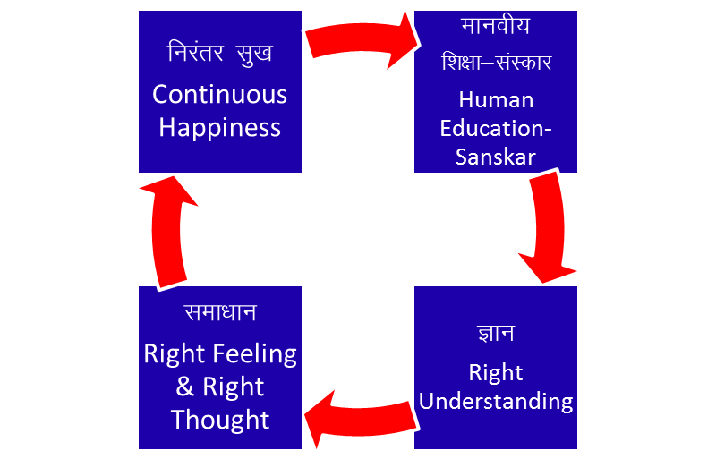
Role of Education-Sanskar f'k{kk&laLdkj dh Hkwfedk
ORDERS 4 voLFkk | UNITS bdkbZ | ACTIVITY fØz;k | INNATENESS /kkj.kk (Self-organisation) | NATURAL CHARACTERISTIC LoHkko (Participation) | INHERITANCE vuq’kaxh;rk
Physical inkFkZ | Soil, Metal feV~Vh] /kkrq | Composition-Decomposition jpuk&fojpuk | Existence vfLrRo | Composition-Decomposition LakxBu&fo?kVu | Constitution based Ikfj.kke vuq’kaxh
Pranic izk.k | Plants, Trees isM+] ikS/ks | "-“ + Respiration “olu&iz”olu | " + Growth iqf’V | " + Nurture-Worsen lkjd&ekjd | Seed based cht vuq’kaxh
Animal tho | Animals, Birds i”kq] i{kh | "-“, " in Body “kjhj esa Selecting/Tasting in I p;u@vkLoknu eSa esa | ", " in Body “kjhj esa Will to live in I eSa esa Tkhus dh vk”kk | ", " in body “kjhj esa Cruelty, Non-cruelty in I eSa esa Øwjrk] vØwjrk | Breed based oa”k vuq’kaxh
Human Kku | Human Beings euq’; | "-“, " in Body “kjhj esa Imaging, Analysing, Selecting/Tasting in I fp=.k] fo'kys'k.k] p;u@vkLoknu eSa esa Potential for Understanding in I le>us dh {kerk eSa esa | ", " in Body “kjhj esa Will to live with continuous happiness in I eSa esa fujarj Lkq[kiwoZd Tkhus dh vk”kk Right Feeling & Thought lek/kku Right Understanding Kku | ", " in body “kjhj esa Perseverance, Bravity, Generosity in I eSa esa /khjrk] ohjrk] mnkjrk | Education-Sanskar based f”k{kk&laLdkj vuq’kaxh
vXyh ih<+h Next Generation
ekuoh; ijaijk
Human Tradition
Natural Characteristic: Participation in larger order

Slide 18
Natural Characteristic LoHkko
Human Living with Animal Consciousness
Wretchedness The feeling I can not take care of my body,
nhurk hence I resort to being dependent on the other
Cunningness The feeling I can not take care of my body,
ghurk hence I resort to beguiling the other
Cruelty The feeling I can not take care of my body,
Øwjrk hence I resort to forcefulness & violence
Human Living with Human Consciousness
Perseverence Being assured that the all-encompassing solution is to
/khjrk understand & to live in harmony at all 4 levels, I live
with this commitment without any perturbation
Bravery The commitment to help the other develop right
ohjrk understanding & to live accordingly
Generosity Readiness to invest oneself, one's body & physical facility
mnkjrk to help the other develop right understanding & to live
accordingly

Slide 19
Innateness: Self-organisation (hone ki vyavastha)
Natural Characteristic: Participation in larger order
Inheritance: Basis of definite conduct across generations
Anushangita = acharan ki nischittha
Continuous Happiness
Fulfilled By Right Feeling & Right Thought (Samadhan)
Fulfilled By Right Understanding (Gyan)

Slide 20
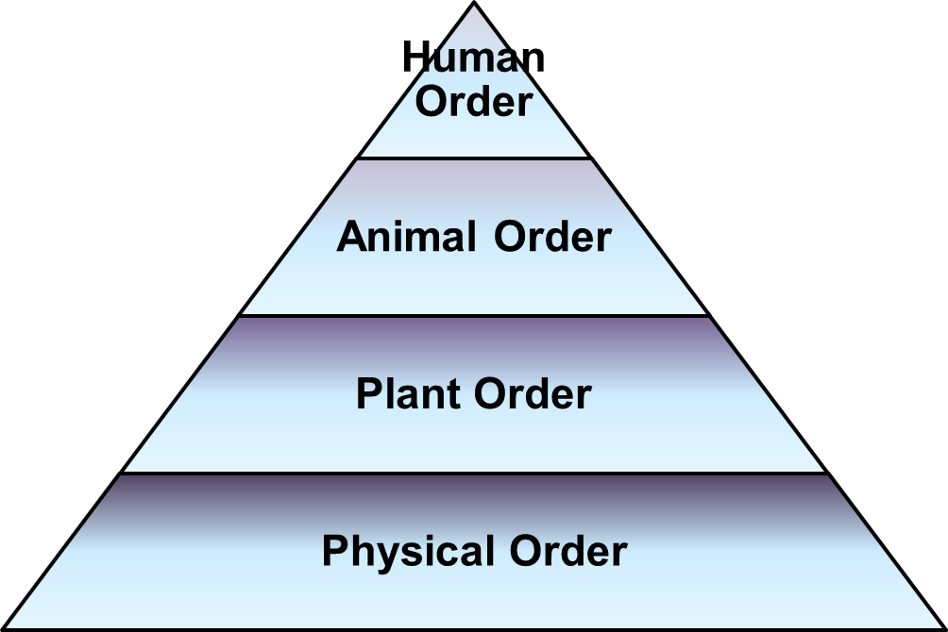
Harmony in Nature iz—fr esa O;oLFkk
Quantity of units in each order
Physical >> Plant >> Animal >> Human
Quantity as per overall enrichment of the whole; and availability of sustaining resources (e.g. number of bees)
Dependence of each order is on all
previous orders
Order of appearance of orders
Physical Plant Animal Human

Slide 21
NOTES
Order of appearance of orders: Physical -> Plant -> Animal -> Human (Human body is most sophisticated, needs most comfortable environment to be – bane rahne ke liye sabse anukool vatavaran ki avashyakta hai)
Quantity of units in each order: Physical >> plant >> animal >> human
Destruction due to ignorance of human order: kosh samapt ho gaya hai… if environment degrades futher, the sequence in which orders will disappear is the reverse order of appearance of orders
Definite Conduct in 3 Orders
Definite Conduct is Naturally Acceptable to Human Beings as well
Definite Conduct in Human Being can be assured only by right Education-Sanskaar
  Education – Develop Right Understanding
  Sanskaar – Abhyas of Right Conduct with Right Feeling

Slide 22
Human Consciousness Animal Consciousness
Knowing (Natural Acceptance) → Assuming
Desires motivated by
Right Understanding, Relationship (Feeling) –niyantrit-- Physical Facility & Sensation
Definite Conduct
Perseverance, Bravery, Generosity in I
eSa esa /khjrk] ohjrk] mnkjrk
Swatantrata
Preconditioning (Assuming without knowing)
Desires motivated without Right Understanding, Relationship (Feeling) --a-niyantrit-- Physical Facility & Sensation
Indefinite Conduct
Wretchedness, Cunningness, Cruelty in I
eSa esa nhurk] ghurk] Øwjrk
Partantrata

Slide 23
Sum Up
Physical order – soil, metals etc.
Plant order – trees, plants etc.
Animal order – animals, birds etc.
Human order – human beings
There is a relationship of mutual fulfilment amongst these 4 orders. So far, the first 3 orders are mutually fulfilling for each other as well as for human beings
It is naturally acceptable to human beings to be fulfilling for these 3 orders. Human beings need to understand this mutual fulfilment; only with this understanding will human beings be able to live with mutual fulfilment
The role of Human Being is to realize this mutual fulfillment – For this, all that human beings need to do is:
  To understand that mutual fulfilment is inherent in nature – we do not have to create it
  To live accordingly – then the mutual fulfilment amongst the 4 orders will be realised (and there is provision in nature for living in a mutually fulfilling manner)
Nature = Collection of Units
= 4 Orders

